Slide 1
Week 1 – Lecture Notes
What has happened - Descriptive Analytics

Slide 2
Introduction

Slide 3
Introduction
Three developments spurred recent explosive growth in the use of analytical methods in business applications:
First development:
  Technological advances, Internet social networks, and data generated from personal electronic devices, produce incredible amounts of data for businesses.
  Businesses want to use these data to improve the efficiency and profitability of their operations, better understand their customers, price their products more effectively, and gain a competitive advantage.
Notes:
Technological advances such as improved point-of-sale scanner technology and the collection of data through e-commerce.

Slide 4
Introduction
Three developments spurred recent explosive growth in the use of analytical methods in business applications: (contd.)
Second development:
  Ongoing research has resulted in numerous methodological developments, including:
    Advances in computational approaches to effectively handle and explore massive amounts of data
    Faster algorithms for optimization and simulation, and
    More effective approaches for visualizing data.

Slide 5
Introduction
Three developments spurred recent explosive growth in the use of analytical methods in business applications:(contd.)
Third development:
  The methodological developments were paired with an explosion in computing power and storage capability.
  Better computing hardware, parallel computing, and cloud computing have enabled businesses to solve big problems faster and more accurately than ever before.
Notes:
Cloud computing, the most recent development, is the remote use of hardware and software over the Internet.

Slide 6
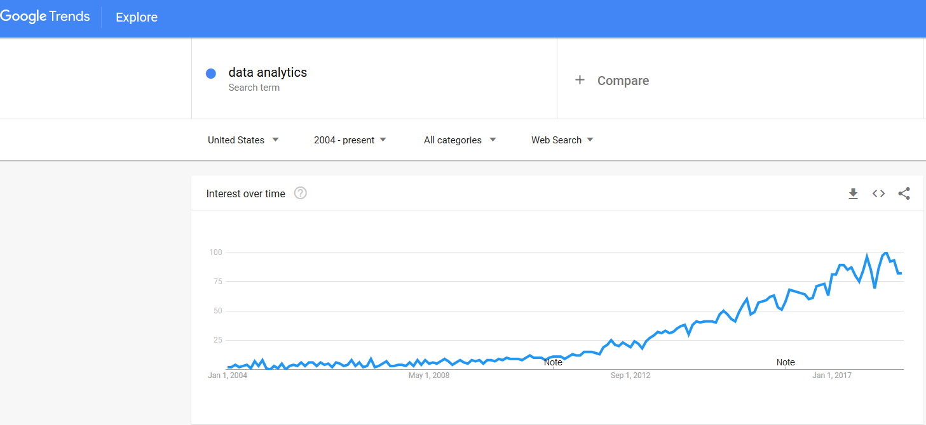
Google Trends Graph of Searches on the term Data Analytics
https://trends.google.com/trends/explore?q=data%20analytics&date=all&geo=US
Notes:
Figure 1.1 is a graph generated by Google Trends that displays the search volume for the word analytics from 2004 to 2013 (projected) on a percentage basis from the peak.
The figure clearly illustrates the recent increase in interest in analytics.

Slide 7
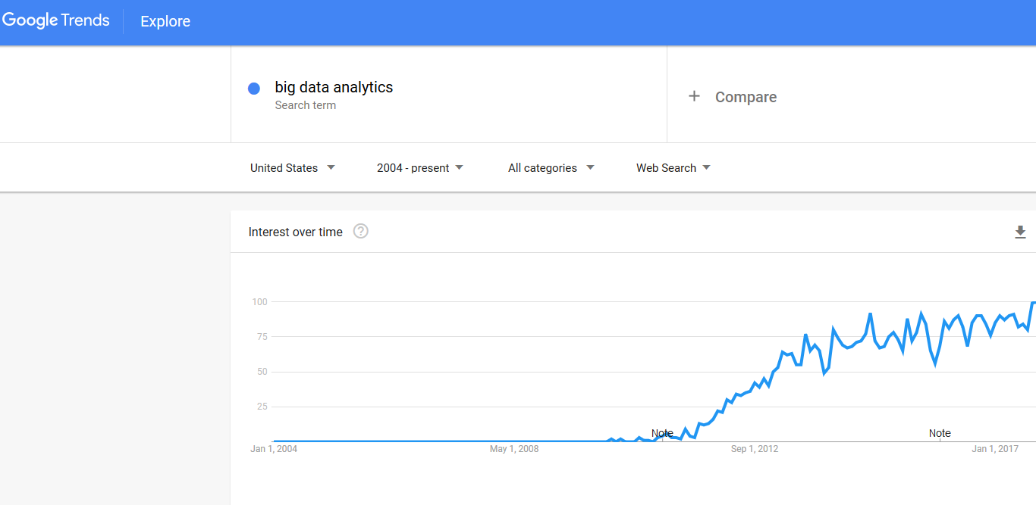
Google Trends Graph of Searches on the term Big Data Analytics
Notes:
Figure 1.1 is a graph generated by Google Trends that displays the search volume for the word analytics from 2004 to 2013 (projected) on a percentage basis from the peak.
The figure clearly illustrates the recent increase in interest in analytics.

Slide 8
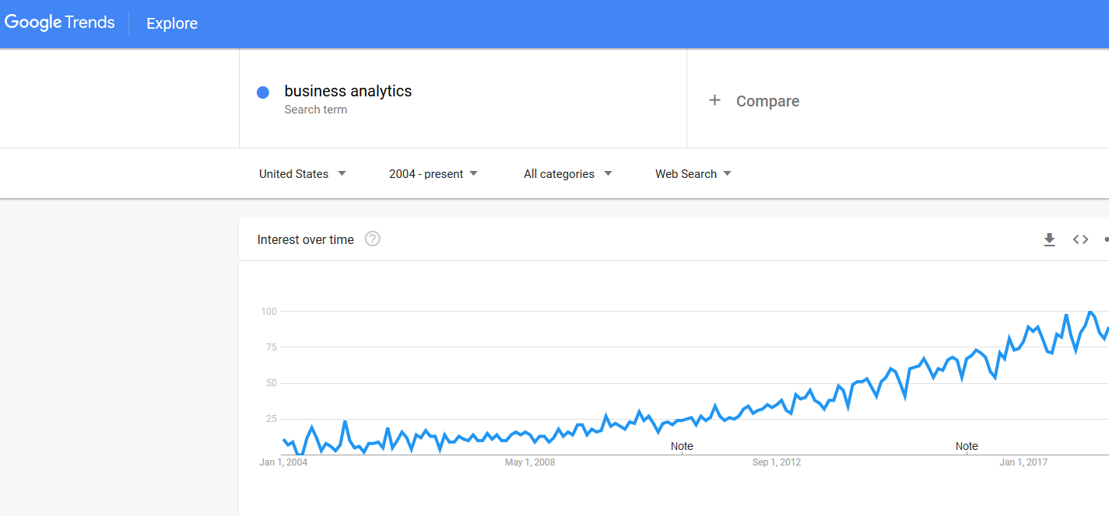
Google Trends Graph of Searches on the term Business Analytics
Notes:
Figure 1.1 is a graph generated by Google Trends that displays the search volume for the word analytics from 2004 to 2013 (projected) on a percentage basis from the peak.
The figure clearly illustrates the recent increase in interest in analytics.

Slide 9
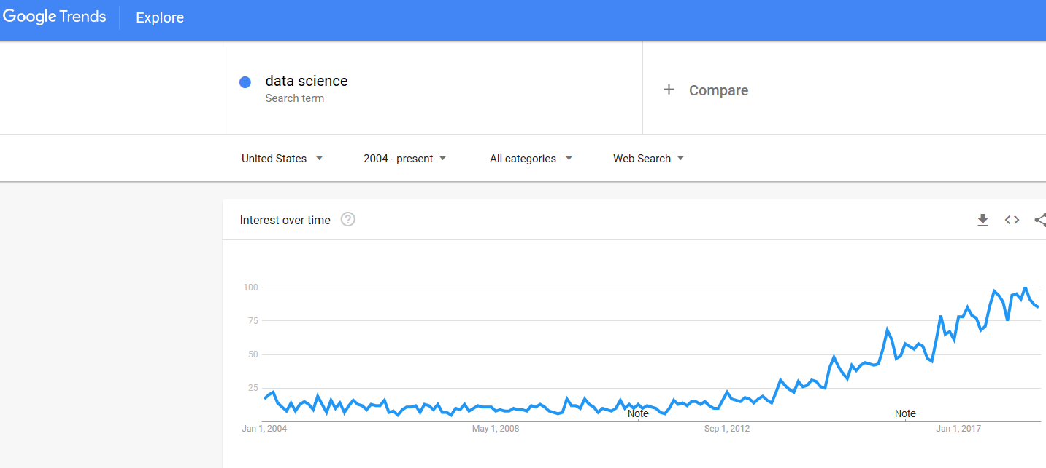
Google Trends Graph of Searches on the term Data Science
Notes:
Figure 1.1 is a graph generated by Google Trends that displays the search volume for the word analytics from 2004 to 2013 (projected) on a percentage basis from the peak.
The figure clearly illustrates the recent increase in interest in analytics.

Slide 10
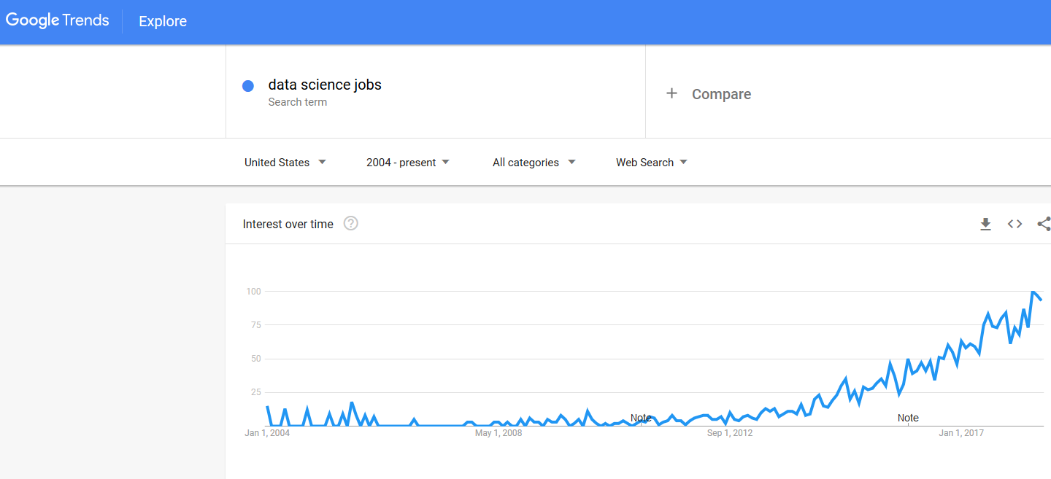
Google Trends Graph of Searches on the term Data Science Jobs
Notes:
Figure 1.1 is a graph generated by Google Trends that displays the search volume for the word analytics from 2004 to 2013 (projected) on a percentage basis from the peak.
The figure clearly illustrates the recent increase in interest in analytics.

Slide 11
Welcome you to the Big data and BA Course
Big data : describes the large volume and complexity of data – both structured and unstructured .
Business Analytics is the scientific process of transforming data into insight for making better decision and is a crucial area of study for students looking to uplift their skills to make unique contribution to their enterprise and also enhance their employment prospects. [p3 Chapter 1]
Notes:
The figure clearly illustrates the recent increase in interest in analytics.

Slide 12
Welcome you to the Big data and BA Course
Business Intelligence: comprises the strategies and technologies used by enterprises for the data analysis of business information. [Dedić N. & Stanier C. (2016)]
Logistics Intelligence: is about Business Intelligence applied to Logistics and Supply Chain operations, services, network of partners’ trust, conjoint data analytics for situation awareness and real time decision support.
Notes:
The figure clearly illustrates the recent increase in interest in analytics.

Slide 13
Decision Making

Slide 14
Decision Making
Managers’ responsibility:
  To make strategic, tactical, or operational decisions.
Strategic decisions:
  Involve higher-level issues concerned with the overall direction of the organization.
  These decisions define the organization’s overall goals and aspirations for the future.

Slide 15
Decision Making
Features of strategic decisions:
  Long term
  Made by senior managers
  More general

Slide 16
Decision Making
Tactical decisions:
  Concern how the organization should achieve the goals and objectives set by its strategy.
  They are usually the responsibility of midlevel management.
Features of tactical decisions:
  Short term
  Made by middle managers
  More specific and detailed

Slide 17
Decision Making
Operational decisions:
  Affect how the firm is run from day to day.
  They are the domain of operations managers, who are the closest to the customer.
Features of Operational decisions :
  Short term
  Made by middle managers
  More specific and detailed

Slide 18
Decision Making
Decision making can be defined as the following process
  Identify and define the problem
  Determine the criteria that will be used to evaluate alternative solutions
  Determine the set of alternative solutions
  Evaluate the alternatives
  Choose an alternative
Notes:
Consider the case of the Thoroughbred Running Company (TRC). Historically, TRC had been a catalog-based retail seller of running shoes and apparel. TRC sales revenue grew quickly as it changed its emphasis from catalog-based sales to Internet-based sales.
Recently, TRC decided that it should also establish retail stores in the malls and downtown areas of major cities. This is a strategic decision that will take the firm in a new direction that it hopes will complement its Internet-based strategy.
TRC middle managers will therefore have to make a variety of tactical decisions in support of this strategic decision, including how many new stores to open this year, where to open these new stores, how many distribution centers will be needed to support the new stores, and where to locate these distribution centers.
Operations managers in the stores will need to make day-to-day decisions regarding, for instance, how many pairs of each model and size of shoes to order
from the distribution centers and how to schedule their sales personnel.

Slide 19
Decision Making
Common approaches to making decisions
  Tradition : We’ve always done it this way
  Intuition : gut feeling (synonyms)
  Rules of thumb
  Using the relevant data available

Slide 20
Business Analytics Defined

Slide 21
Business Analytics Defined
Business analytics:
  Scientific process of transforming data into insight for making better decisions.
  Used for data-driven or fact-based decision making, which is often seen as more objective than other alternatives for decision making.

Slide 22
Business Analytics Defined
Tools of business analytics can aid decision making by:
  Creating insights from data
  Improving our ability to more accurately forecast for planning
  Helping us quantify risk
  Yielding better alternatives through analysis and optimization

Slide 23
A Categorization of Analytical Methods
and Models

Slide 24
A Categorization of Analytical Methods and Models
Descriptive analytics: It encompasses the set of techniques that describes what has happened in the past.
Examples - data queries, reports, descriptive statistics, data visualization (data dashboards), data-mining techniques, and basic what-if spreadsheet models.
Data query - It is a request for information with certain characteristics from a database.

Slide 25
A Categorization of Analytical Methods and Models
Data dashboards - Collections of tables, charts, maps, and summary statistics that are updated as new data becomes available.
  Use of dashboards
    To help management monitor specific aspects of the company’s performance related to their decision-making responsibilities.
    For corporate-level managers, daily data dashboards might summarize sales by region, current inventory levels, and other company-wide metrics.
    Front-line managers may view dashboards that contain metrics related to staffing levels, local inventory levels, and short-term sales forecasts.

Slide 26
A Categorization of Analytical Methods and Models
Predictive analytics: It consists of techniques that use models constructed from past data to predict the future or ascertain the impact of one variable on another.
  Survey data and past purchase behavior may be used to help predict the market share of a new product.

Slide 27
A Categorization of Analytical Methods and Models
Techniques used in Predictive Analytics: contd.
Data mining
Simulation
Used to find patterns or relationships among elements of the data in a large database; often used in predictive analytics.
It involves the use of probability and statistics to construct a computer model to study the impact of uncertainty on a decision.
Notes:
Example for Data Mining:
A large grocery store chain might be interested in developing a new targeted marketing campaign that offers a discount coupon on potato chips.
By studying historical point-of-sale data, the store may be able to use data mining to predict which customers are the most likely to respond to an offer on discounted chips by purchasing higher-margin items such as beer or soft drinks in addition to the chips, thus increasing the store’s overall revenue.
Example for Simulation:
Banks often use simulation to model investment and default risk in order to stress test financial models.
Used in the pharmaceutical industry to assess the risk of introducing a new drug.

Slide 28
A Categorization of Analytical Methods and Models
Prescriptive Analytics: It indicates a best course of action to take
  Models used in prescriptive analytics:
Optimization models
Simulation optimization
Decision analysis
Models that give the best decision subject to constraints of the situation.
Combines the use of probability and statistics to model uncertainty with optimization techniques to find good decisions in highly complex and highly uncertain settings.
Used to develop an optimal strategy when a decision maker is faced with several decision alternatives and an uncertain set of future events.
It also employs utility theory, which assigns values to outcomes based on the decision maker’s attitude toward risk, loss, and other factors.

Slide 29
A Categorization of Analytical Methods and Models
Optimization models
Model | Field | Purpose
Portfolio models | Finance | Use historical investment return data to determine the mix of investments that yields the highest expected return while controlling or limiting exposure to risk.
Supply network design models | Operations | Provide the cost-minimizing plant and distribution center locations subject to meeting the customer service requirements.
Price markdown models | Retailing | Use historical data to yield revenue-maximizing discount levels and the timing of discount offers when goods have not sold as planned.

Slide 30
Business Analytics in Practice

Slide 31
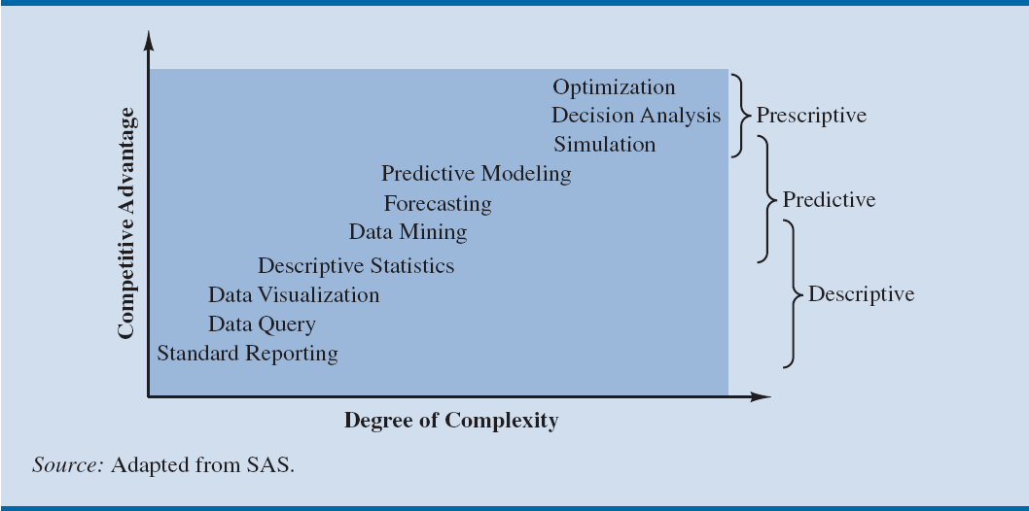
Figure 1.2 - The Spectrum of Business Analytics
Notes:
Companies that apply analytics often follow a trajectory similar to that shown in Figure 1.2.
Organizations start with basic analytics in the lower left.
As they realize the advantages of these analytic techniques, they often progress to more sophisticated techniques in an effort to reap the derived competitive advantage.
Predictive and prescriptive analytics are sometimes therefore referred to as advanced analytics.

Slide 32
Business Analytics in Practice
Types of applications of analytics by application area
Financial analytics
  Use of predictive models
    To forecast future financial performance
    To assess the risk of investment portfolios and projects
    To construct financial instruments such as derivatives

Slide 33
Business Analytics in Practice
Financial analytics (contd.)
  Use of prescriptive models
    To construct optimal portfolios of investments
    To allocate assets, and
    To create optimal capital budgeting plans.
  Simulation is also often used to assess risk in the financial sector
Notes:
Example for use of prescriptive models:
GE Asset Management uses optimization models to decide how to invest its own cash received from insurance policies and other financial products, as well as the cash of its clients such as Genworth Financial.
The estimated benefit from the optimization models was $75 million over a five-year period.
Example for use of simulation:
Deployment by Hypo Real Estate International of simulation models to successfully manage commercial real estate risk.

Slide 34
Business Analytics in Practice
Human Resource (HR) analytics
  New area of application for analytics
  The HR function is charged with ensuring that the organization
    Has the mix of skill sets necessary to meet its needs
    Is hiring the highest-quality talent and providing an environment that retains it, and
    Achieves its organizational diversity goals.
Notes:
Example for Human Resource (HR) Analytics:
Sears Holding Corporation (SHC), owners of retailers Kmart and Sears, Roebuck and Company, has created an HR analytics team inside its corporate HR function.
The team uses descriptive and predictive analytics to support employee hiring and to track and influence retention.

Slide 35
Business Analytics in Practice
Marketing analytics
  Marketing is one of the fastest growing areas for the application of analytics.
  A better understanding of consumer behavior through the use of scanner data and data generated from social media has led to an increased interest in marketing analytics.

Slide 36
Business Analytics in Practice
Marketing analytics (contd.)
  A better understanding of consumer behavior through marketing analytics leads to:
    The better use of advertising budgets
    More effective pricing strategies
    Improved forecasting of demand
    Improved product line management, and
    Increased customer satisfaction and loyalty
Notes:
Example of high-impact marketing analytics:
Automobile manufacturer Chrysler teamed with J. D. Power and Associates to develop an innovate set of predictive models to support its pricing decisions for automobiles.
These models help Chrysler to better understand the ramifications of proposed pricing structures (a combination of manufacturer’s suggested retail price, interest rate offers, and rebates) and, as a result, to improve its pricing decisions.
The models have generated an estimated annual savings of $500 million.

Slide 37
Business Analytics in Practice
Health care analytics
  Descriptive, predictive, and prescriptive analytics are used:
    To improve patient, staff, and facility scheduling
    Patient flow
    Purchasing
    Inventory control
  Use of prescriptive analytics for diagnosis and treatment
Notes:
Example for the use of prescriptive analytics for diagnosis and treatment:
Working with the Georgia Institute of Technology, Memorial Sloan-Kettering Cancer Center developed a real-time prescriptive model to determine the optimal placement of radioactive seeds for the treatment of prostate cancer.
Using the new model, 20–30 percent fewer seeds are needed, resulting in a faster and less invasive procedure.

Slide 38
Business Analytics in Practice
Supply chain analytics
  The core service of companies such as UPS and FedEx is the efficient delivery of goods, and analytics has long been used to achieve efficiency.
  The optimal sorting of goods, vehicle and staff scheduling, and vehicle routing are all key to profitability for logistics companies such as UPS, FedEx, and the like.
  Companies can benefit from better inventory and processing control and more efficient supply chains.
Notes:
Example for supply chain analytics:
ConAgra Foods uses predictive and prescriptive analytics to better plan capacity utilization by incorporating the inherent uncertainty in commodities pricing.
ConAgra realized a 100 percent return on their investment in analytics in under three months—an unheard of result for a major technology investment.

Slide 39
Business Analytics in Practice
Analytics for government and nonprofits
  To drive out inefficiencies
  To increase the effectiveness and accountability of programs
  Analytics for nonprofit agencies
    To ensure their effectiveness and accountability to their donors and clients.
Notes:
Example of analytics for government agencies:
The New York State Department has worked with IBM to use prescriptive analytics in the development of a more effective approach to tax collection. The result was an increase in collections from delinquent payers of $83 million over two years.
Example of analytics for nonprofit agencies:
Catholic Relief Services (CRS) is the official international humanitarian agency of the U.S. Catholic community. The CRS mission is to provide relief for the victims of both natural and human-made disasters and to help people in need around the world through its health, educational, and agricultural programs.
CRS uses an analytical spreadsheet model to assist in the allocation of its annual budget based on the impact that its various relief efforts and programs will have in different countries.

Slide 40
Business Analytics in Practice
Sports analytics
  Used for player evaluation and on-field strategy in professional sports.
    To assess players for the amateur drafts and to decide how much to offer players in contract negotiations.
    Professional motorcycle racing teams that use sophisticated optimization for gearbox design to gain competitive advantage.

Slide 41
Business Analytics in Practice
Sports analytics (contd.)
  The use of analytics for off-the-field business decisions is also increasing rapidly.
    Using prescriptive analytics, franchises across several major sports dynamically adjust ticket prices throughout the season to reflect the relative attractiveness and potential demand for each game.

Slide 42
Business Analytics in Practice
Web analytics - It is the analysis of online activity, which includes, but is not limited to, visits to Web sites and social media sites such as Facebook and LinkedIn.
  Leading companies apply descriptive and advanced analytics to data collected in online experiments to:
    Determine the best way to configure Web sites,
    Position ads, and
    Utilize social networks for the promotion of products and services
Notes:
Online experimentation involves exposing various subgroups to different versions of a Web site and tracking the results.
Because of the massive pool of Internet users, experiments can be conducted without risking the disruption of the overall business of the company.
Such experiments are proving to be invaluable because they enable the company to use trial-and-error in determining statistically what makes a difference in their Web site traffic and sales.

Slide 43
Conclusion and Notes
This chapter helps you get a high-level understanding of business analytics.
It helps you to prepare your first assignment which is an online forum.
Shorts videos are available in your Moodle page on Business Analytics and Big Data.

